Slide 1
DECS Grading server
Submitted by,
Arnab Bhakta (23m0835)
Vinayak Andicote (23m0823)

Slide 2
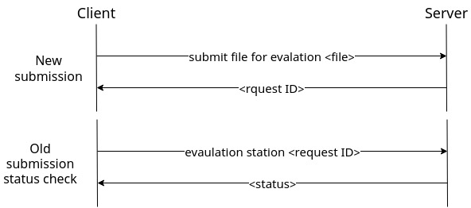
Client request flow
Now instead of one long lasting request, client sends two types of request
Client sends the files to be submitted, server receives the file and replies with a request ID
Client uses the request ID to check status of its submission

Slide 3
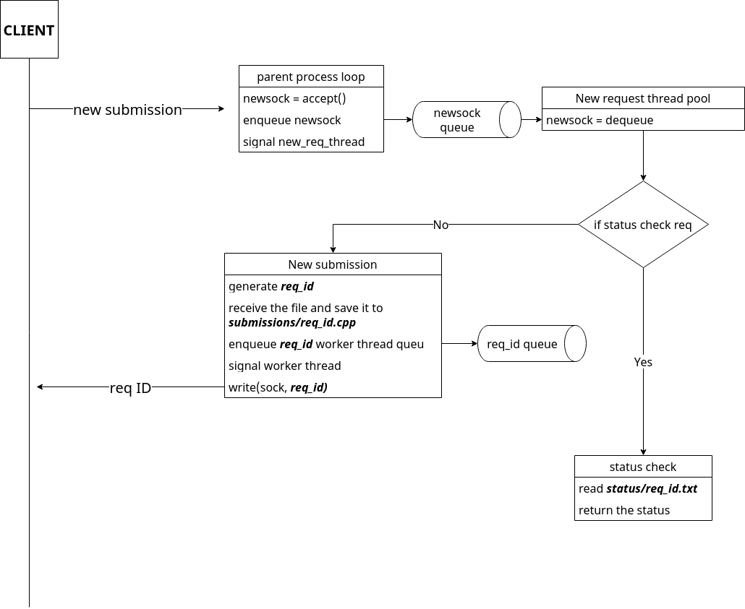
How server handles new file ( new request thread pool)
Generate req_id by a counter or uuid
Saves the file in new_req_file/req_id.cpp
Signal worker thread with req_id
Returns the req_id

Slide 4
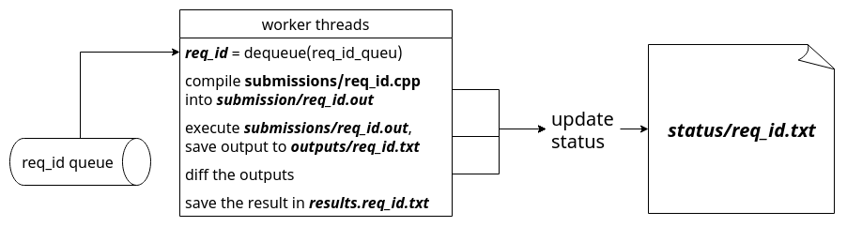
Worker thread
DeQueue req_id from the worker thread queue
Compile, run, diff
Update status/req_id.txt at each step

Slide 5
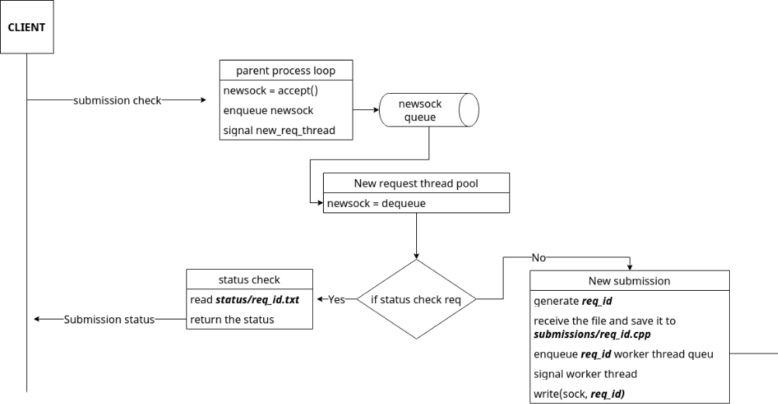
How server handles status (status check thread pool)
Client will send the req_id
Server checks the status in status/req_id.txt
Returns the status

Slide 6
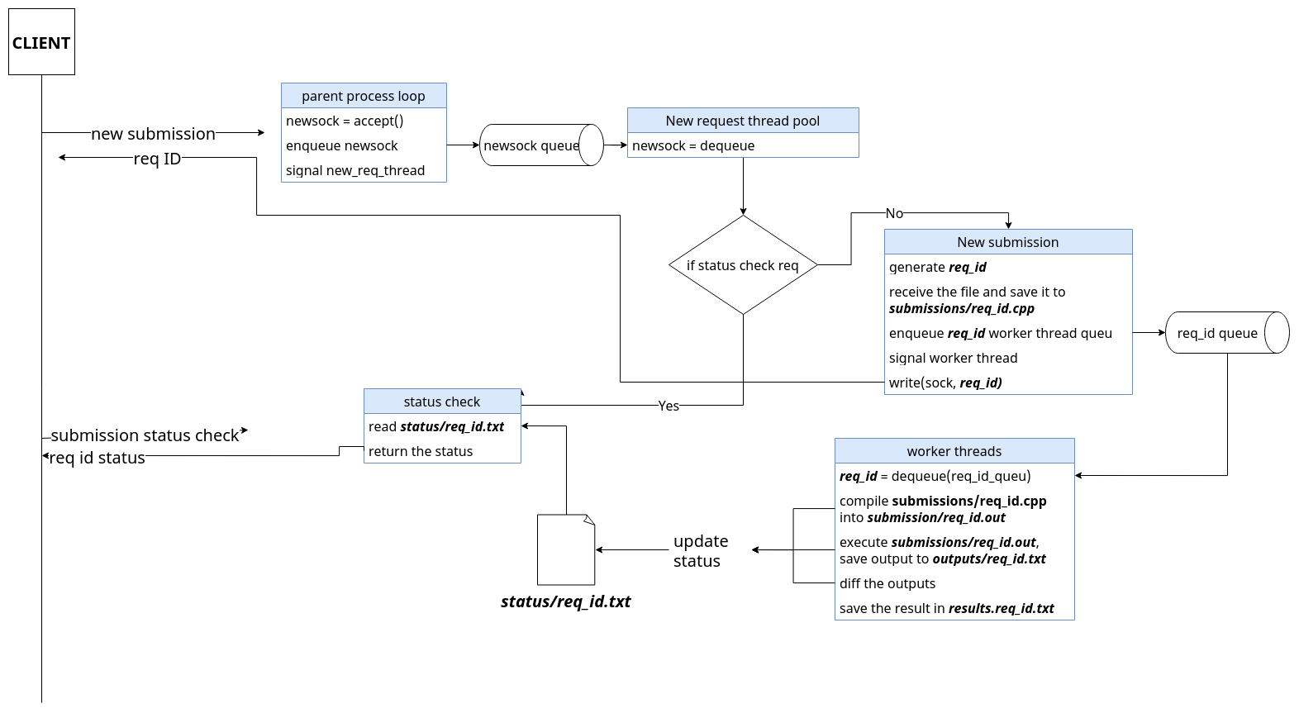
Complete flow

Slide 7
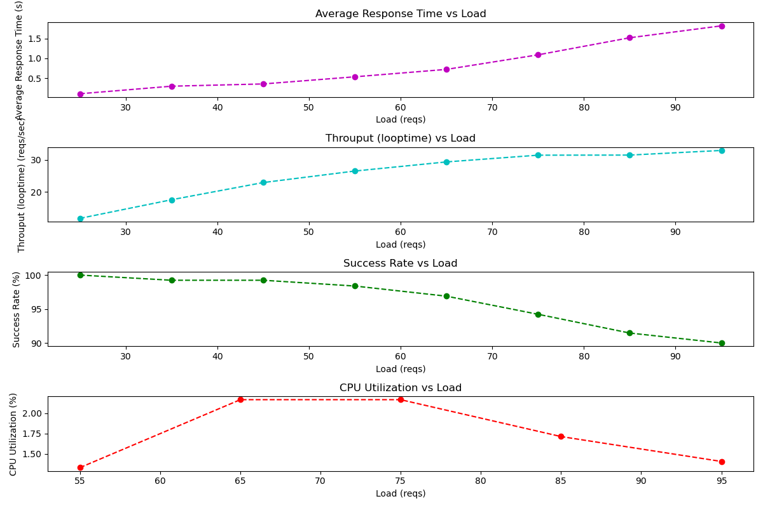
Theoretical GoodPut = 40/
Version 1 performance

Slide 8
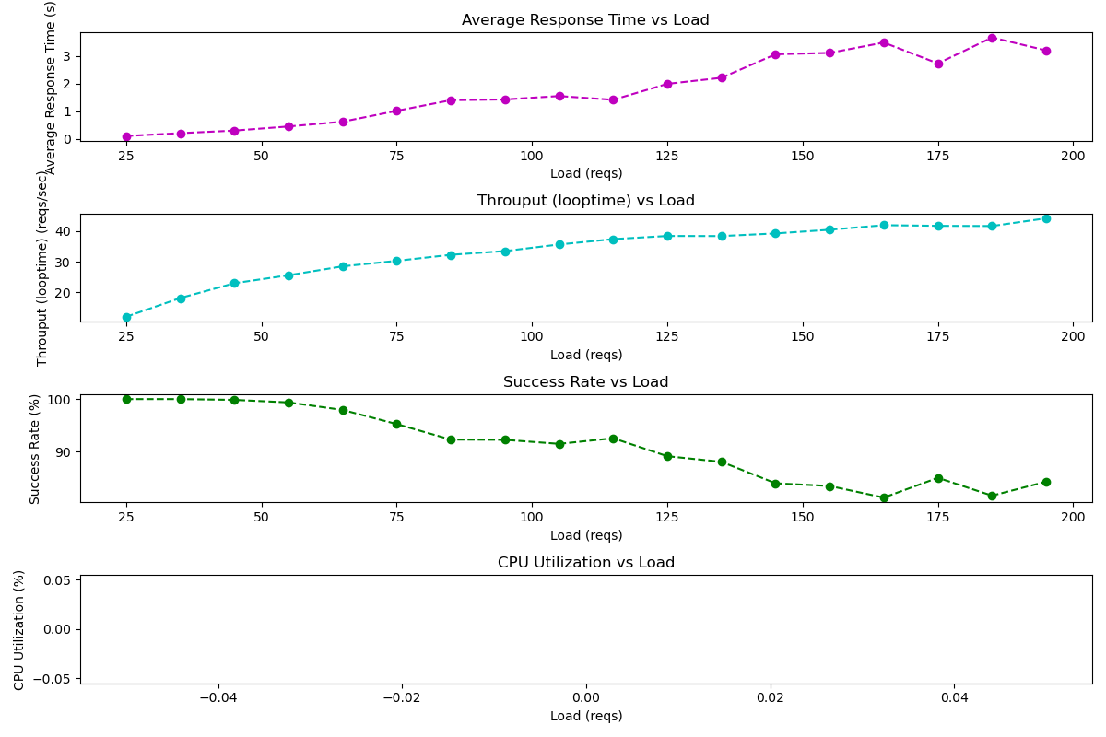
Version 2 performance

Slide 9
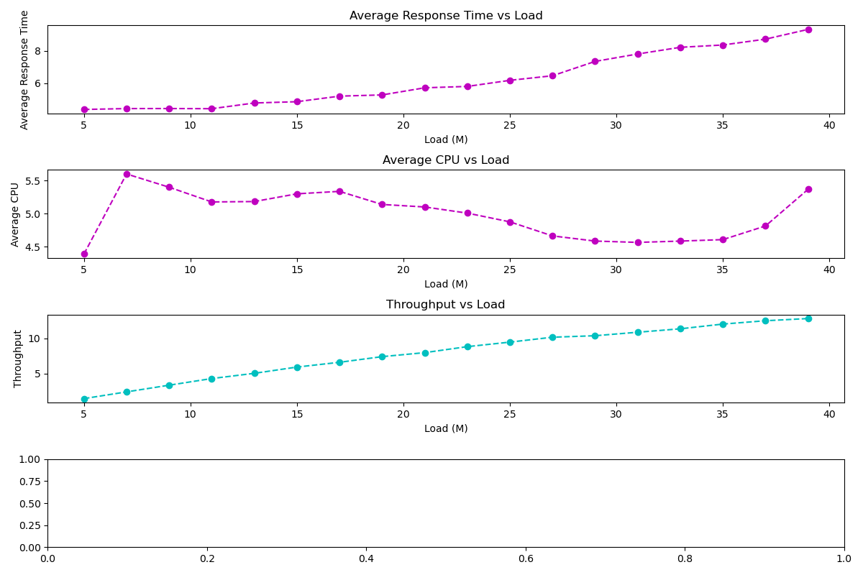
Version 3 performance

Slide 10
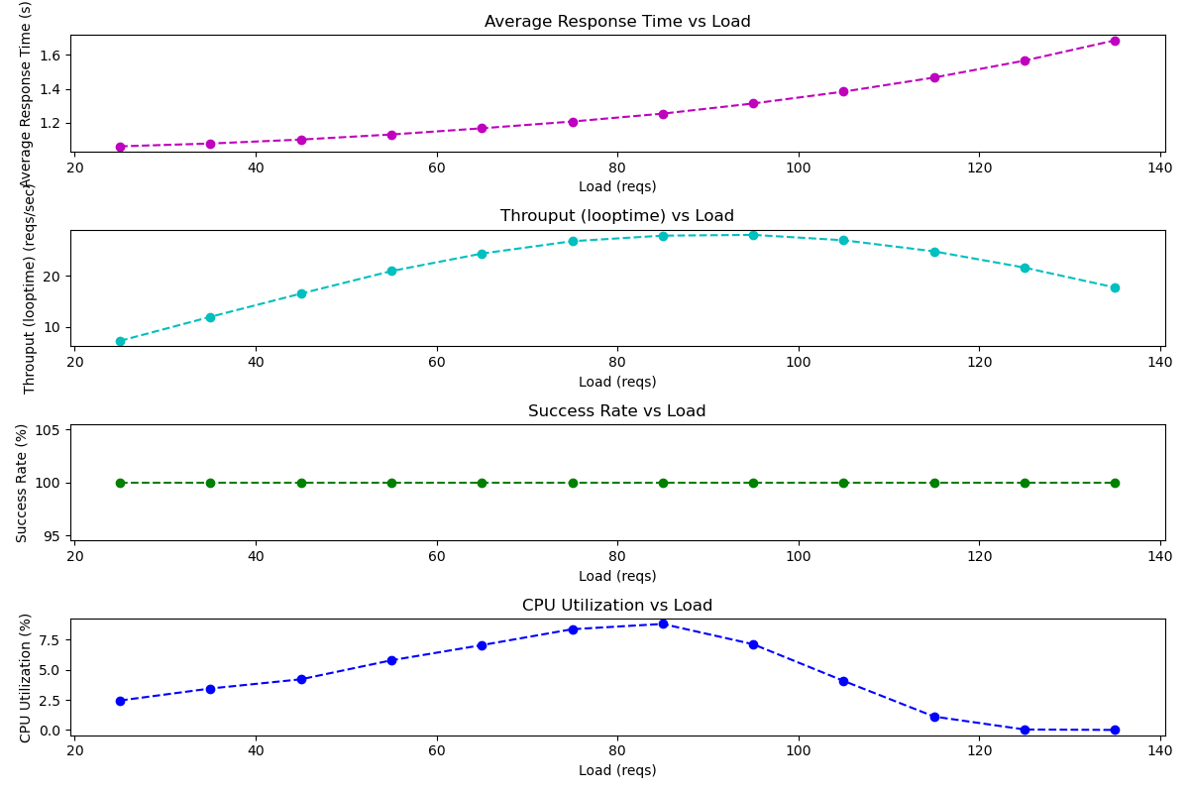
Version 3 performance

Slide 11
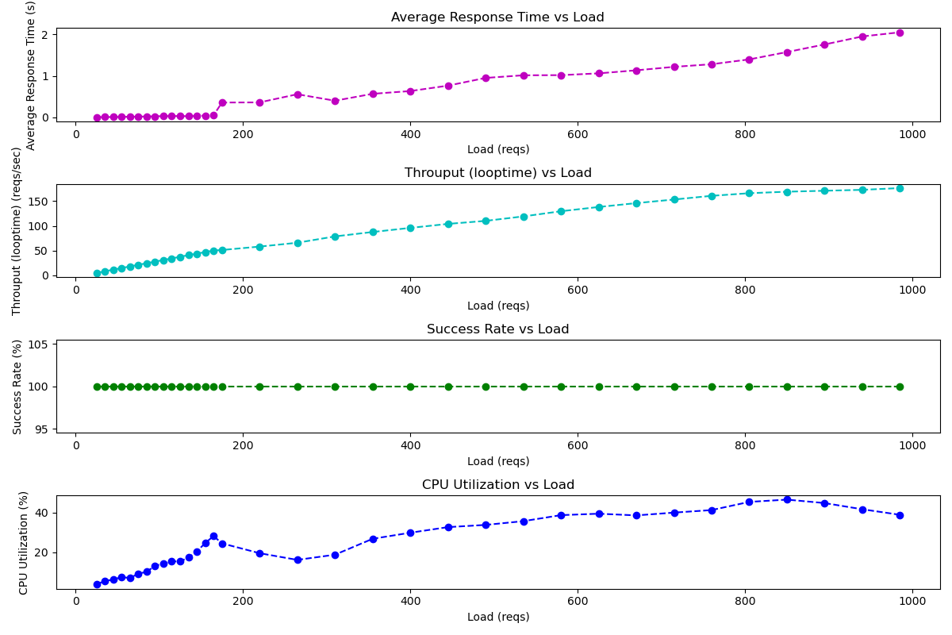
Version 4 performance

Slide 12
END

